Slide 1


Project Name
Bike Sharing Demand Prediction

Slide 2

Project presented by group Three :
Anjali Lodhe
Jayshree Suryawanshi
Manish Lawande
Shruti Pawar
Vaishnavi Pansare
Vijay Shewale
Guidance by:
Aishwarya Anil Mate

Slide 3

Problem Statement :
Build a regression model to predict the count of total rental bikes that includes both casual and registered users based on the given attributes, such as season, year, month, hour, holiday, weekday, working day, weather situation, normalized temperature, normalized feeling temperature, normalized humidity, normalized wind speed, count of casual users, and number of registered users.
Main Goal :
The main objective is to develop a predictive model that can estimate total bike fare rates based on various factors such as weather, time of day, day of week, etc. This can be useful for businesses or bike sharing service providers to improve their efficiency, understand demand patterns and plan resources accordingly. Since the model is the regression model so, the count of total rental bikes would be the target variable.

Slide 4
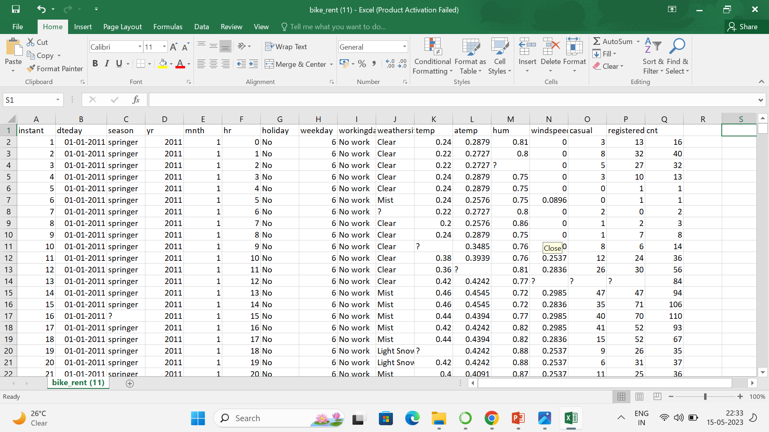
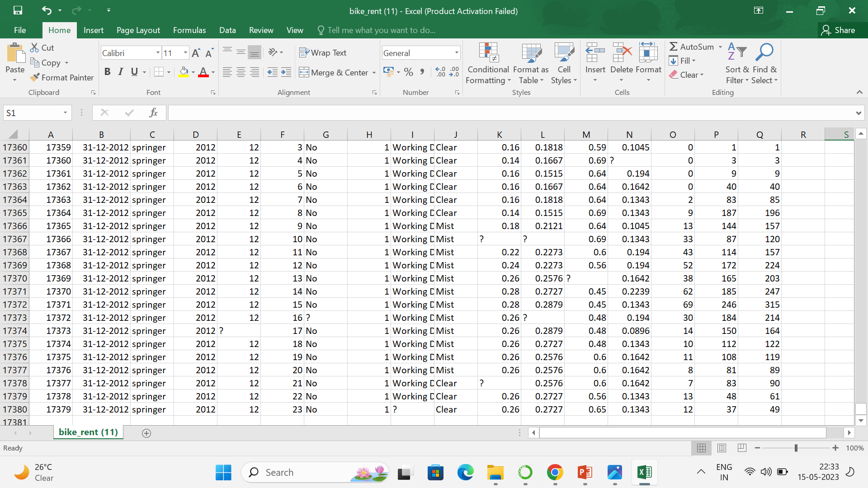
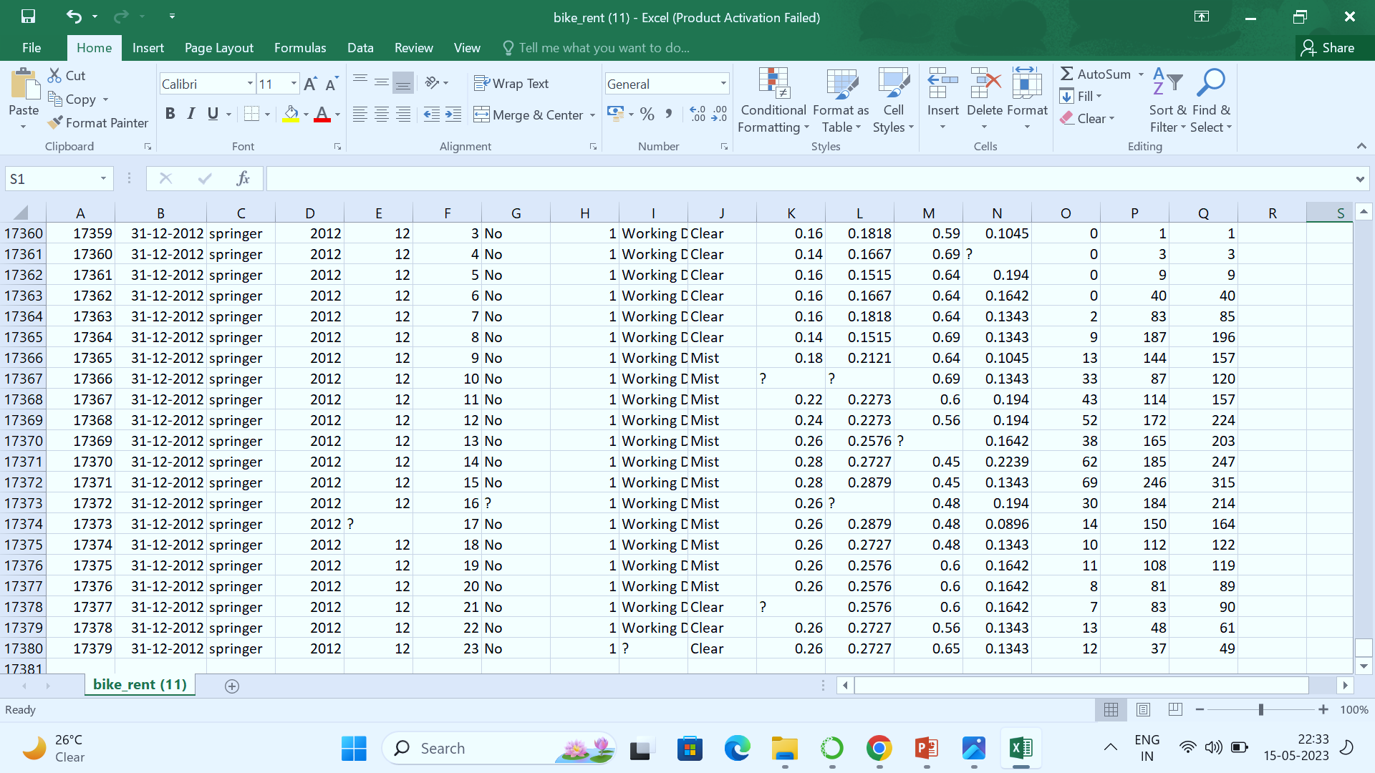
Dataset Information:
Bike sharing systems are new generation of traditional bike rentals where whole process from membership, rental and return back has become automatic. Through these systems, user is able to easily rent a bike from a particular position and return back at another position.
This dataset contains the hourly and daily count of rental bikes between years 2011 and 2012 in Capital bike share system with the corresponding weather and seasonal information. also this dataset has 17379 rows and 17 columns in it.

Slide 5


Attributes Information :
Instant: Index number
Dteday: Date (Format: YYYY-MM-DD)
Season: Season Name
Yr: Year
Month: Month (1-12)(Jan-Dec)
Hr: Hour(0 to 23)
Holiday: Whether the holiday is there or not
Weekday: Day of the week
Workingday: Whether it is a working day or not
Weathersit: Weather situation
Atemp: Normalized feeling temperature
Hum: Normalized humidity. The Values are divided by 100
Windspeed: Normalized Wind speed. Values are divided by 67
Casual: Count of casual users
Registered: Number of registered users
Cnt: Count of total rental biked including both casual and registered

Slide 6
Process of predicting bike sharing demand with best regression model :
1. Exploratory Data Analysis
Loading the dataset and libraries
Data cleaning
Typecasting the attributes
Missing value analysis
2. Attributes distributions and trends
Monthly distribution of counts
Yearly distribution of counts
Outliers analysis
3. Normality test
4. Correlation matrix
5. Split the dataset into train and test dataset
6. Encoding the categorical features
7. Modelling the training dataset
8. Cross Validation Prediction
9. Model performance on train and test dataset
Decision Tree Regression Prediction
Random Forest Prediction
10. Model Evaluation Metrics
R-squared score
Root mean square error
Hyper-parameter Tuning
11.Choosing best model for predicting bike rental count
12.Deployment

Slide 7
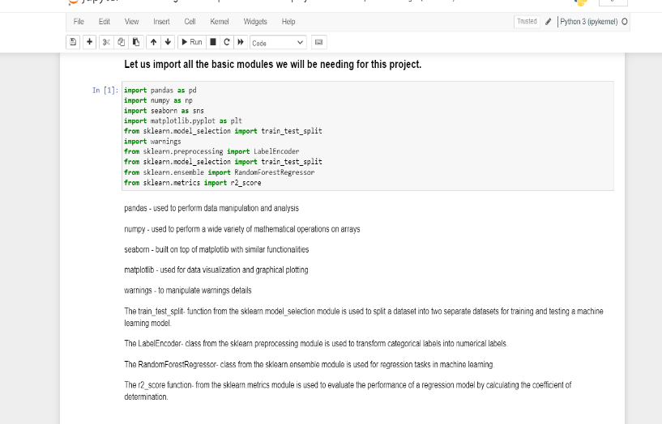
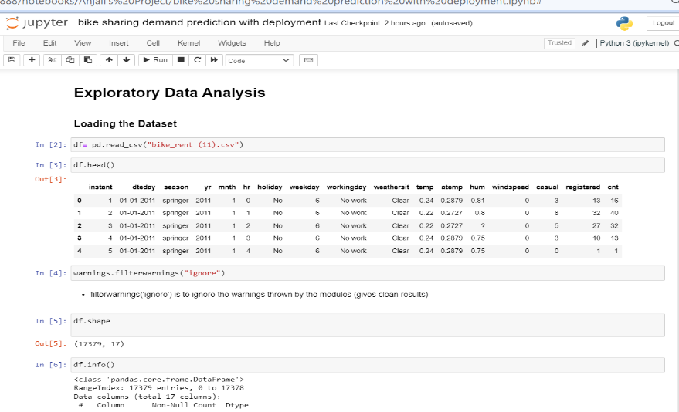
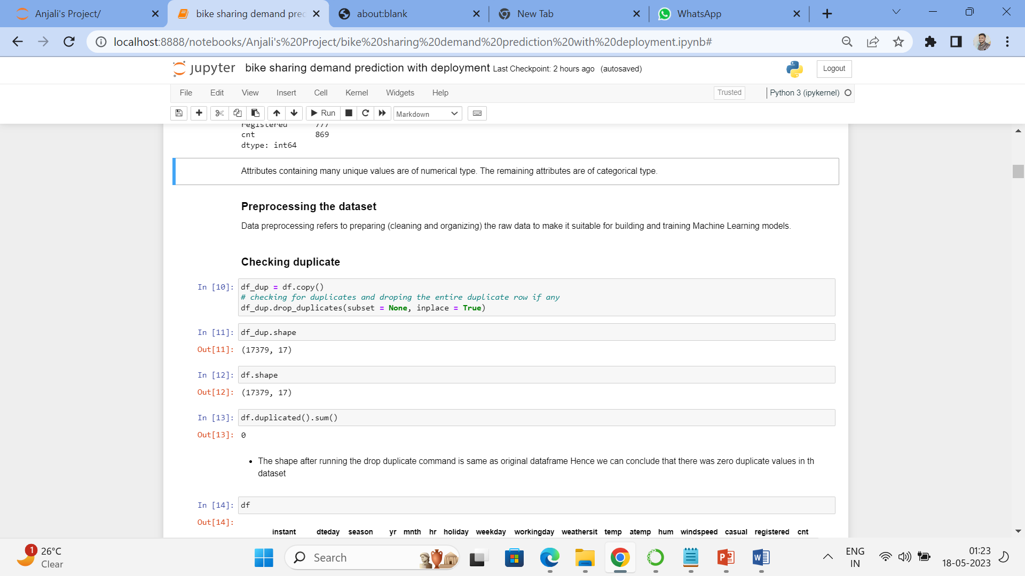
Exploratory Data Analysis :
In EDA first we have started with loading the dataset and libraries and also we have written the importance and use of the all libraries that we have imported.
Then after that we started with Preprocessing the dataset Data preprocessing refers to preparing (cleaning and organizing) the raw data.
In this first we have checked duplicates in the dataset
and we found that there is no duplicates in the dataset

Slide 8
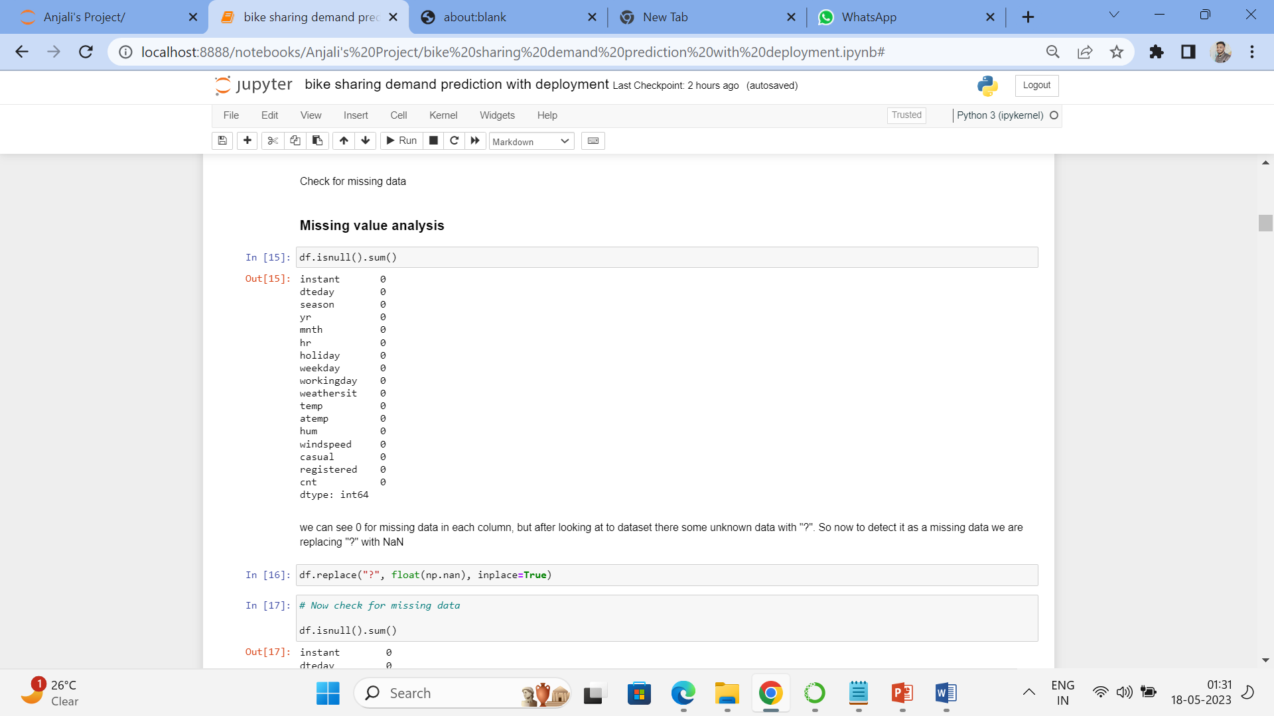
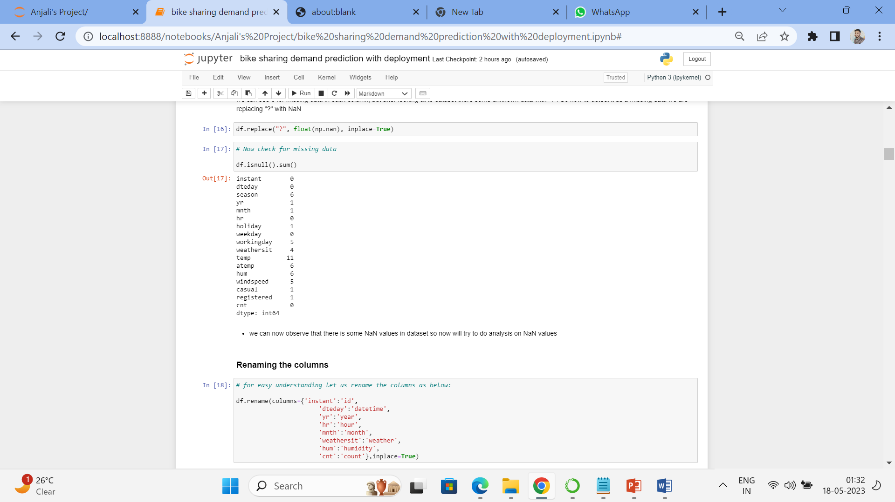
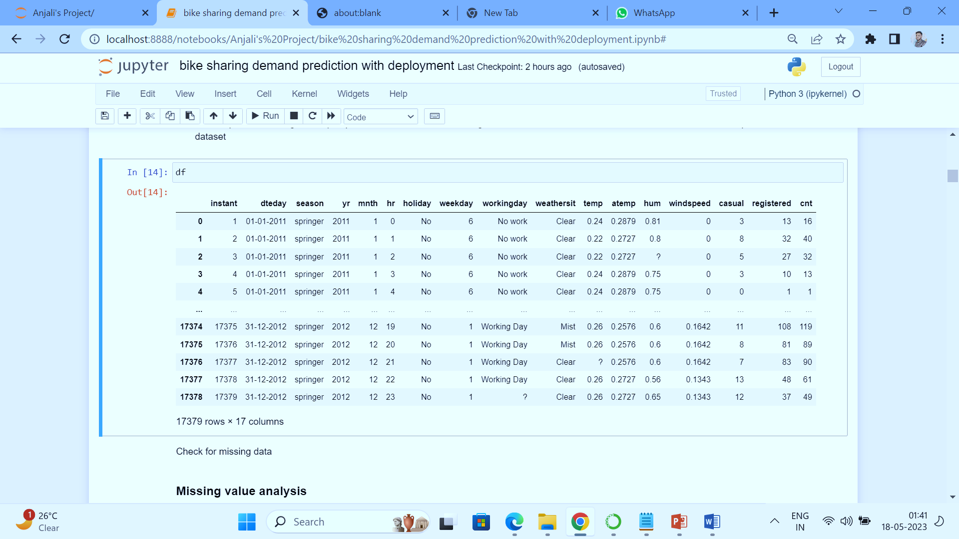
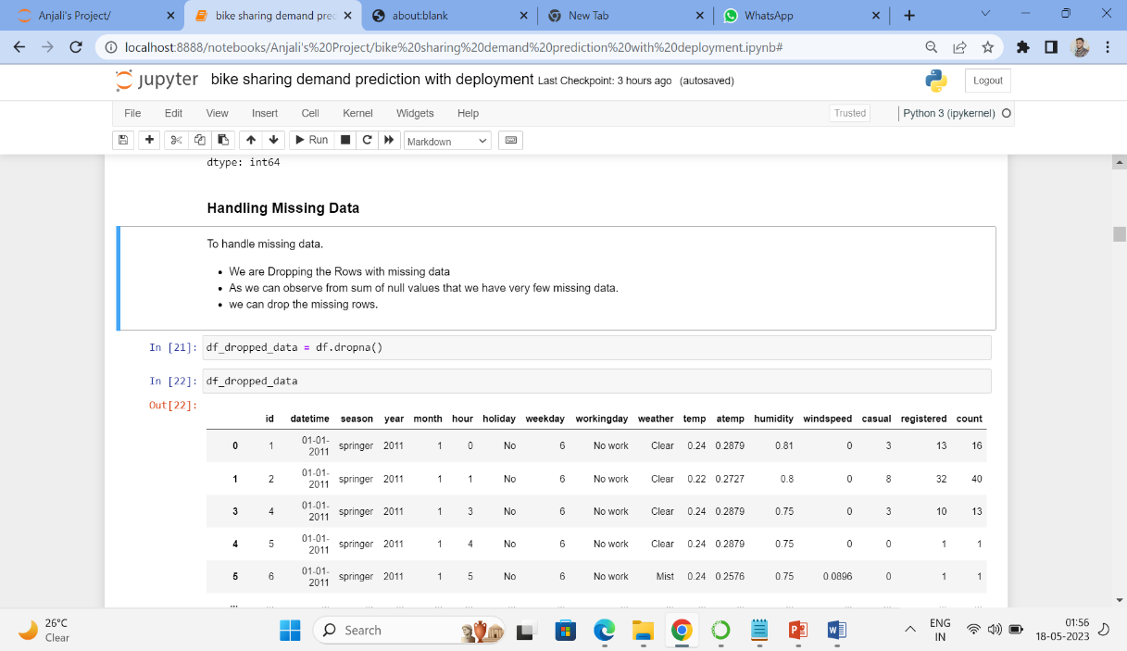
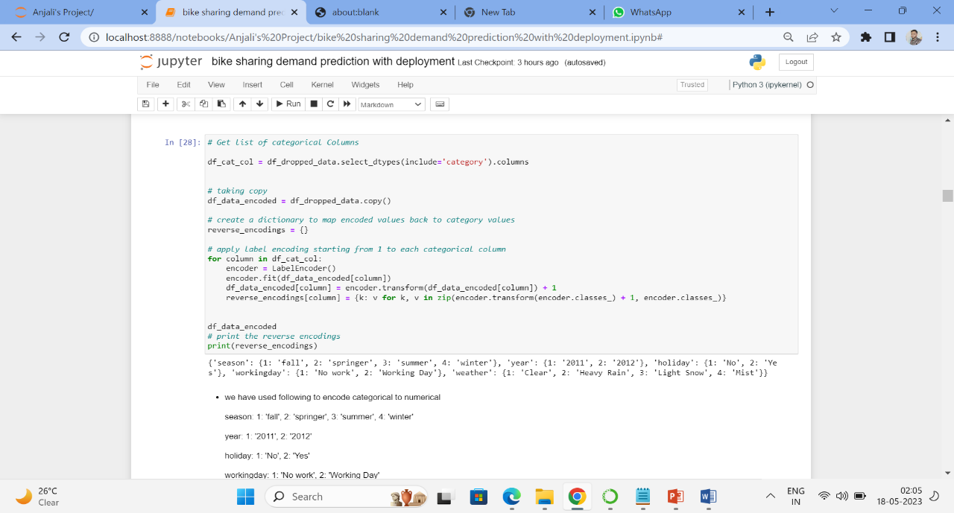
Missing value analysis we have done on this dataset and there some unknown data with "?". So now to detect it as a missing data we are replacing "?" with NaN
then we have renamed the column names for better understanding
Handling Missing Data to handle missing data. We have Dropped the Rows with missing data because we have very few missing data. Then we have done Typecasting the columns.
Done label encoding for categorical columns

Slide 9
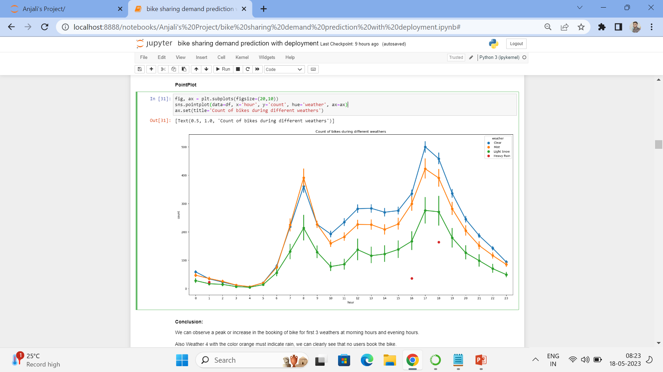
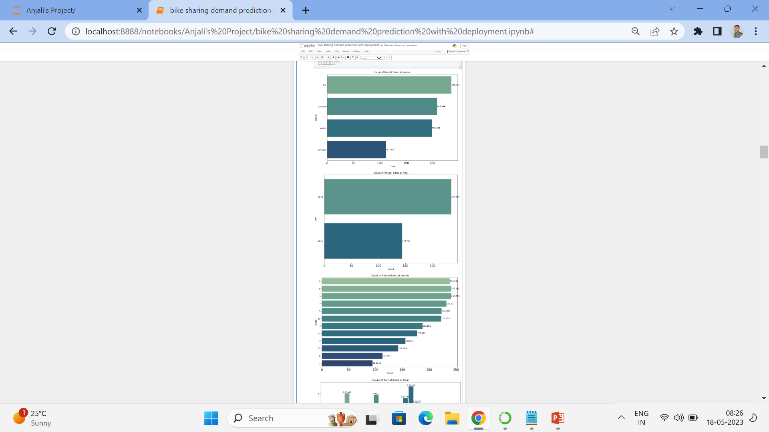
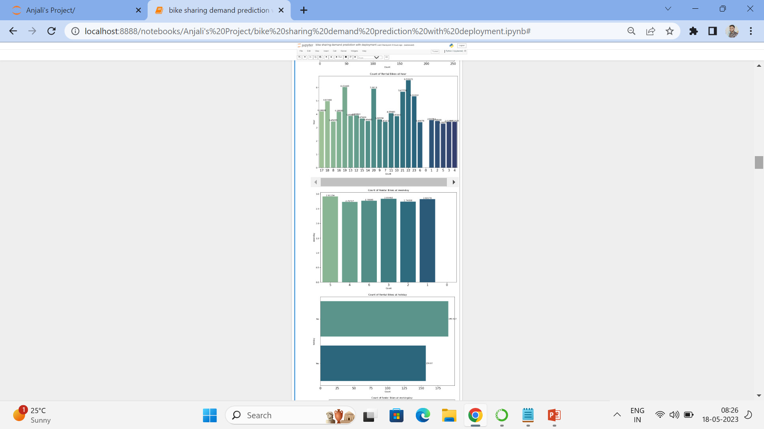
Data Visualization :
Point Plot : we can plotted a point plot for Count of bikes during different weathers, in this we have observe that a peak or increase in the booking of bike for first 3 weathers at morning hours and evening hours.
Also Weather 4 with the color red must indicate rain, we can clearly see that no users book the bike.
Bar plot : we have plotted a bar plot for Count of rental bikes at different seasons, year, month, holiday, working day and weather condition has been shown pic.
The bike rental count is highest during fall season, followed by summer, winter and lowest at spring season. The year 2012 has higher count compared to 2011.
.

Slide 10
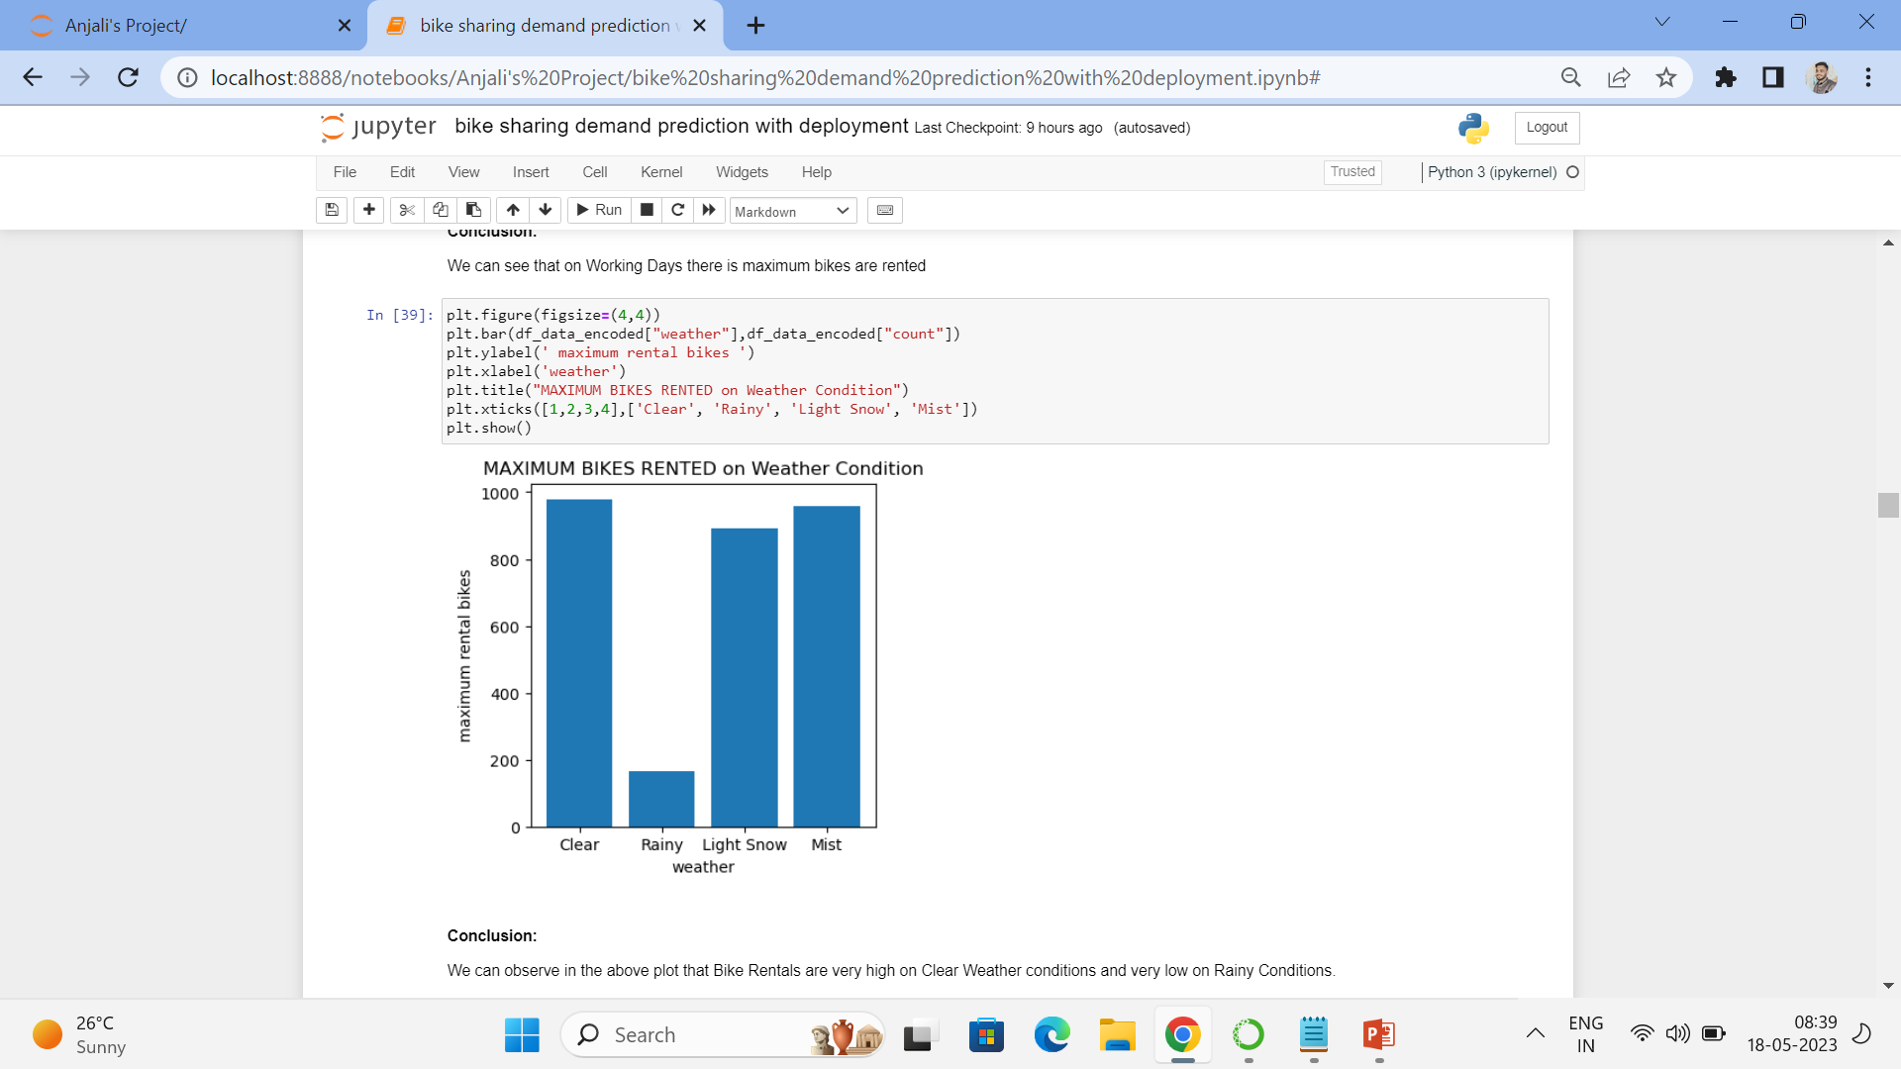
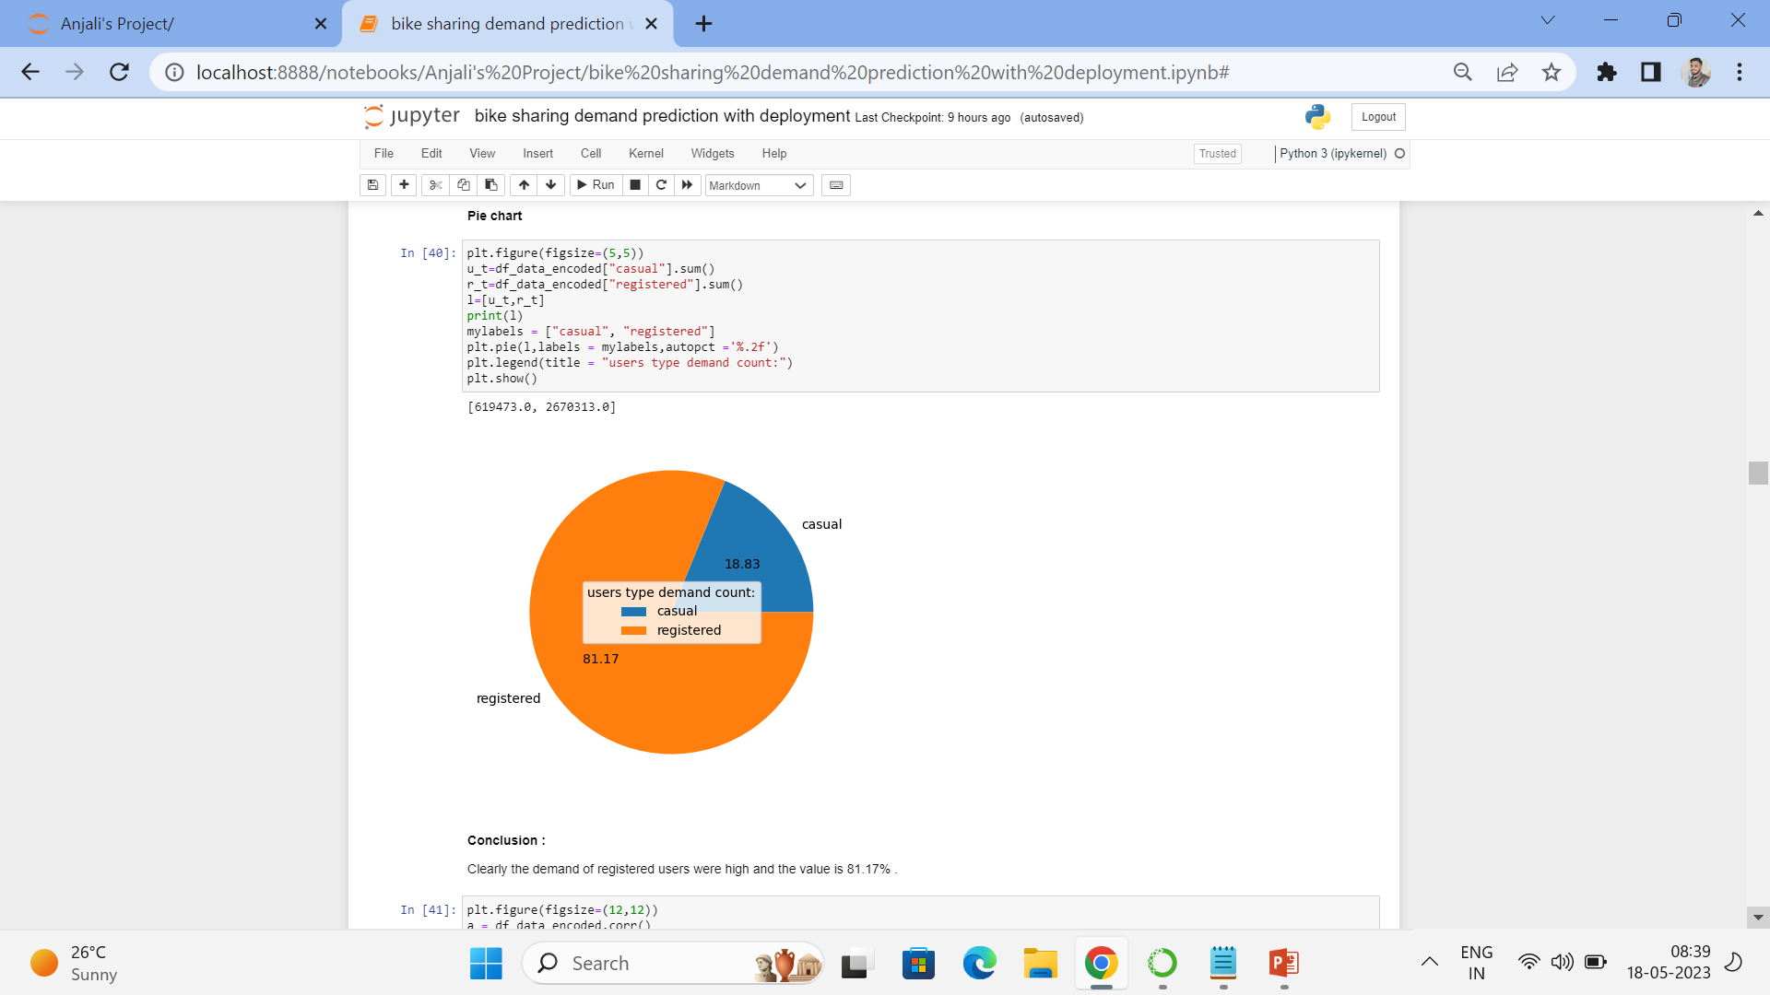
Bar Plot :
We have plotted bar plot for MAXIMUM BIKES RENTED on Weather Condition We can observe in the above plot that Bike Rentals are very high on Clear Weather conditions and very low on Rainy Conditions.
Pie Plot :
we have then done with pie chart for casual and registered users there we observe that the demand of registered users were high and the value is 81.17% .

Slide 11
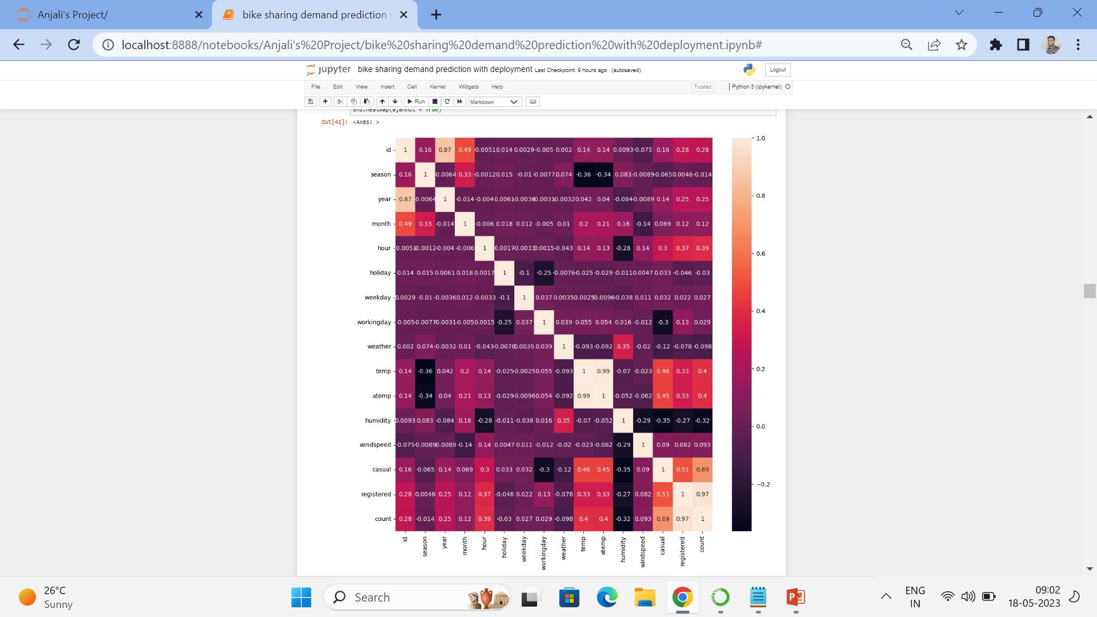
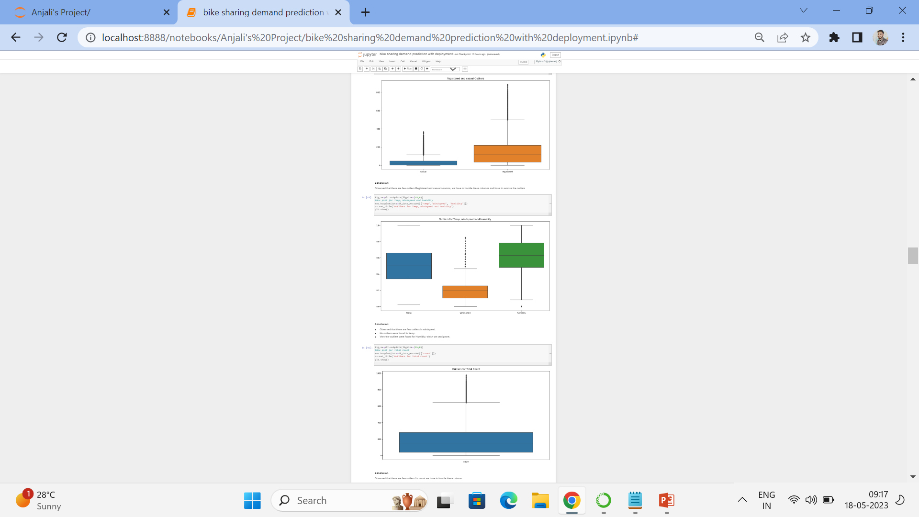
Correlation Matrix :
Heatmap:
We correlation analysis there we observe that:
Registered Users are very Strongly Correlated with total_count - 0.97
casual also Positively strong correlated with total_count - 0.69
hour is positively correlated with total_count - 0.39
temp is positively correlated with total_count - 0.4
Humidity is Negatively correlated with total_count - -0.32
Outliers Analysis :
After correlation we started with outliers analysis there we Observed that there are few outliers Registered and casual columns, then Observed that there are few outliers in windspeed.
No outliers were found for temp.
Very few outliers were found for Humidity.
Observed that there are few outliers for count.

Slide 12
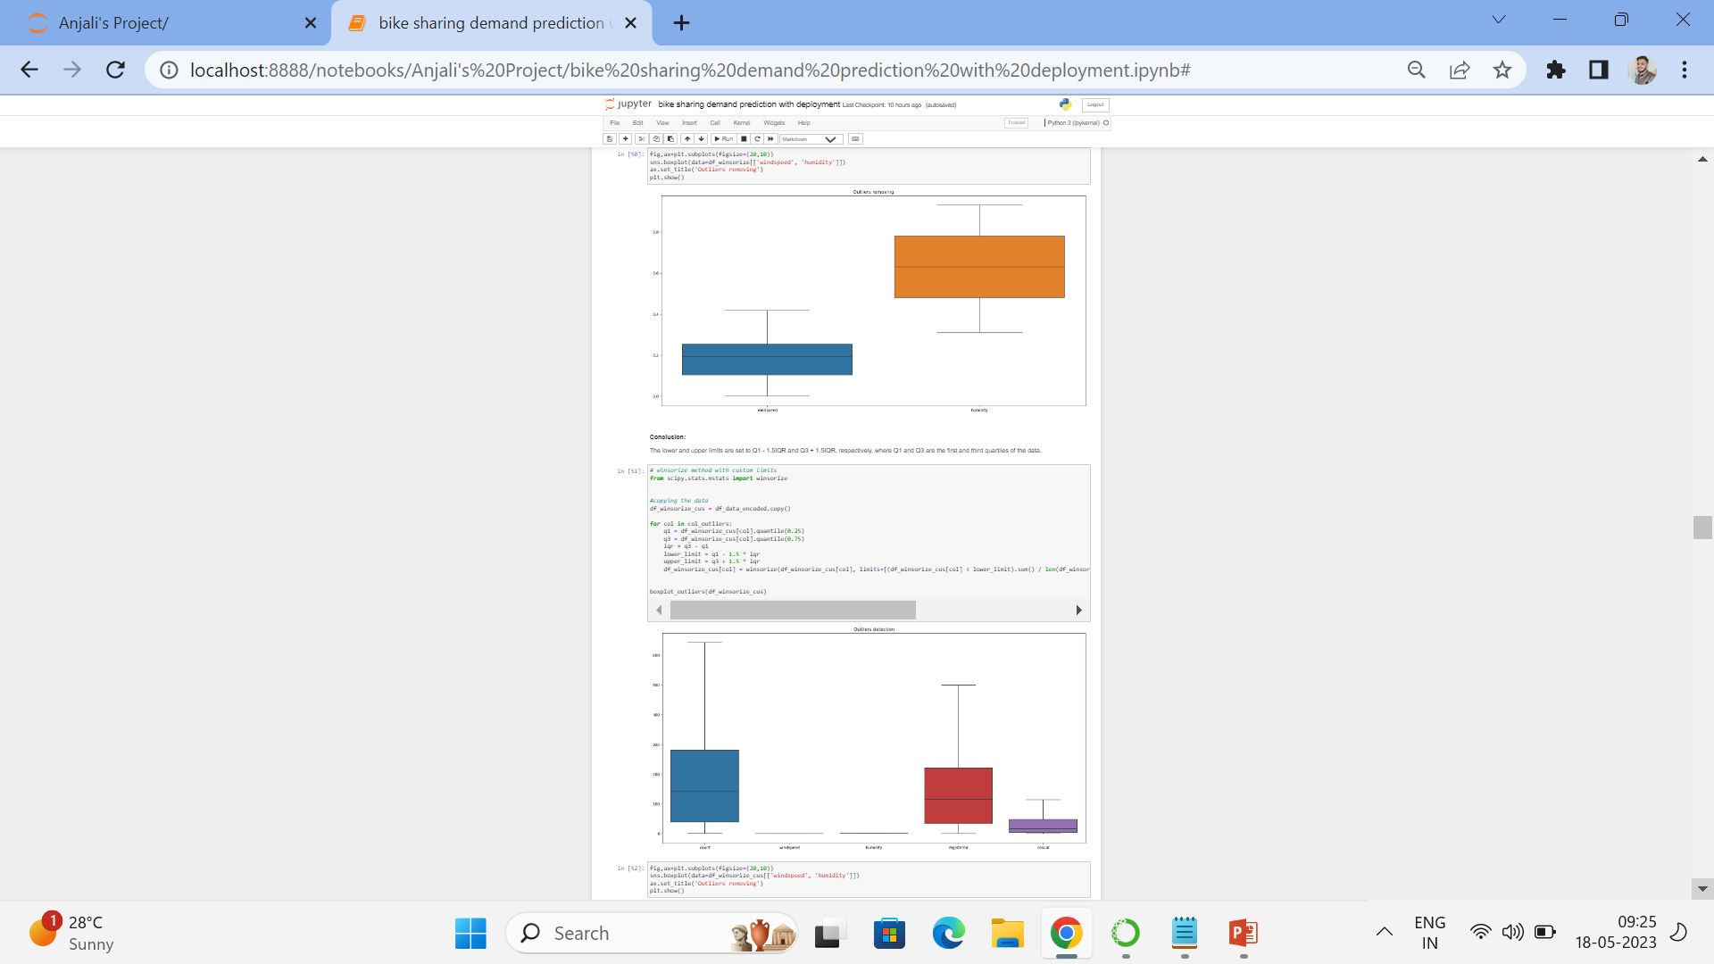
Approaches to handle outliers:
To handle the outliers we used following methods to remove it:
Winsorize the data : Winsorization is the process of replacing the extreme values of statistical data in order to limit the effect of the outliers on the calculations
Transform the data : Transformation of the skewed variables may also help correct the distribution of the variables
Capping : In this method, we first initialize a data frame/series. Then, we set the values of a lower and higher percentile.
IQR : IQR is the middle 50% of data, which is Q3-Q1. Q1 is the first quartile, Q3 is the third quartile, and quartile divides an ordered dataset into 4 equal-sized groups.
By using this methods we observed that for the Methods IQR, capping with 0.1 and Winsorizing, datset is completely outlier free. to determine the best method, we implemented sample random regressor and then find the efficiency for both data sets.

Slide 13
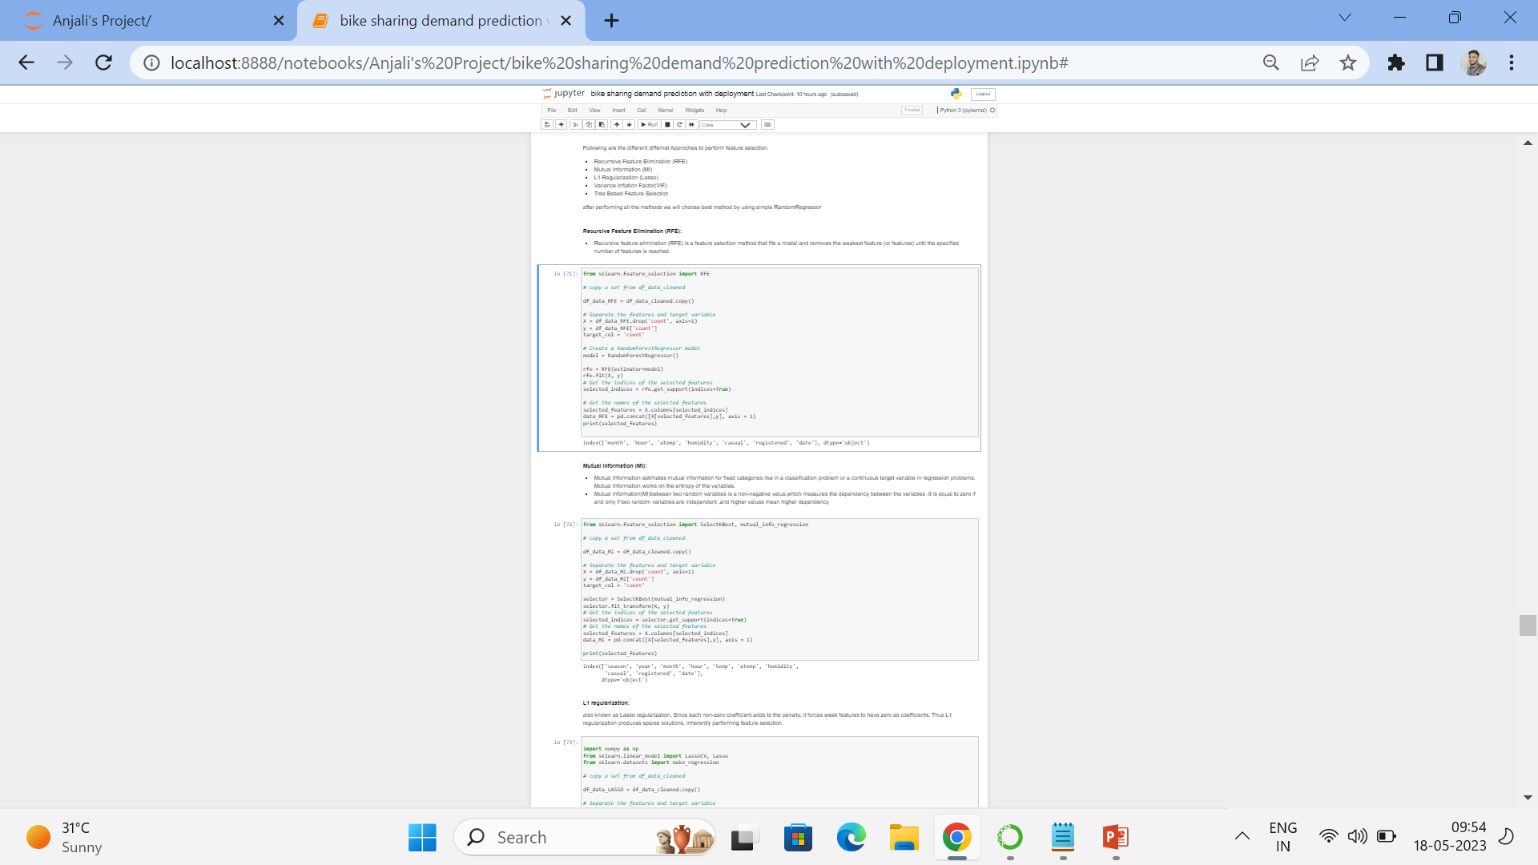
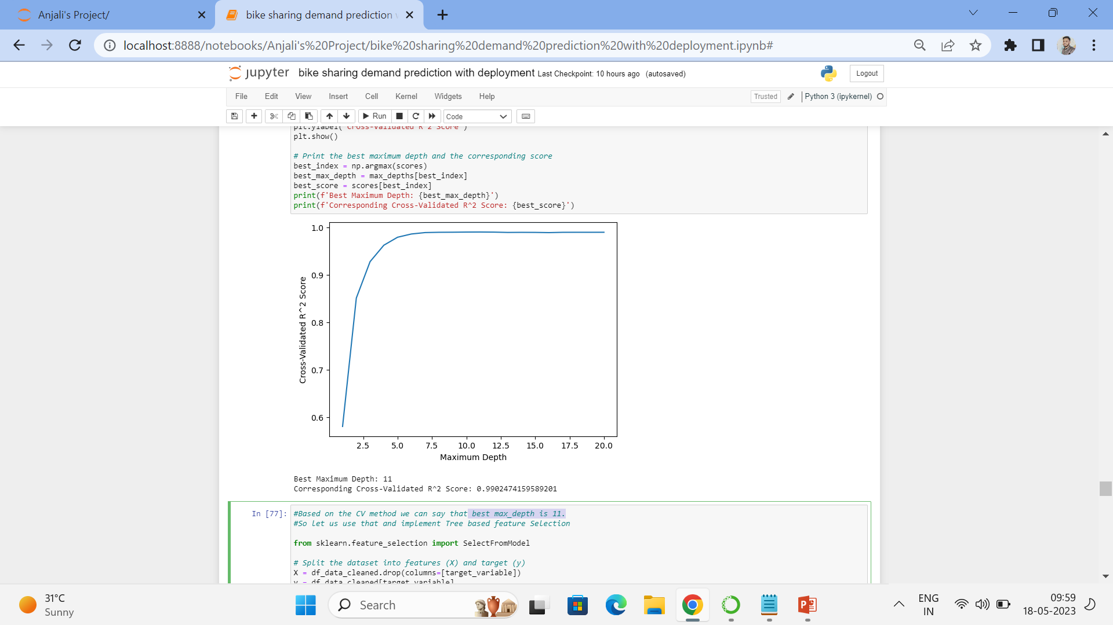
FEATURE ENGINEERING:
Before starting the feature engineering we drop two columns id because Its only an id and datetime because this has the date, since we already have seperate columns for 'year' and 'month' .
Then we started with Feature Selection in this we used five approaches:
Recursive Feature Elimination (RFE)
Mutual Information (MI)
L1 Regularization (Lasso)
Variance Inflation Factor(VIF)
Tree Based Feature Selection
for Decision tree feature selection method we required max depth parameter so to get best max_depth we used cross-validation technique and then we found the best max_depth is 11.
After this methods we found that the best features season, year, month, hour, weekday, working day, registered, casual and date.
we need to predict the target variable irrespective of year further so, we eliminated year parameter

Slide 14
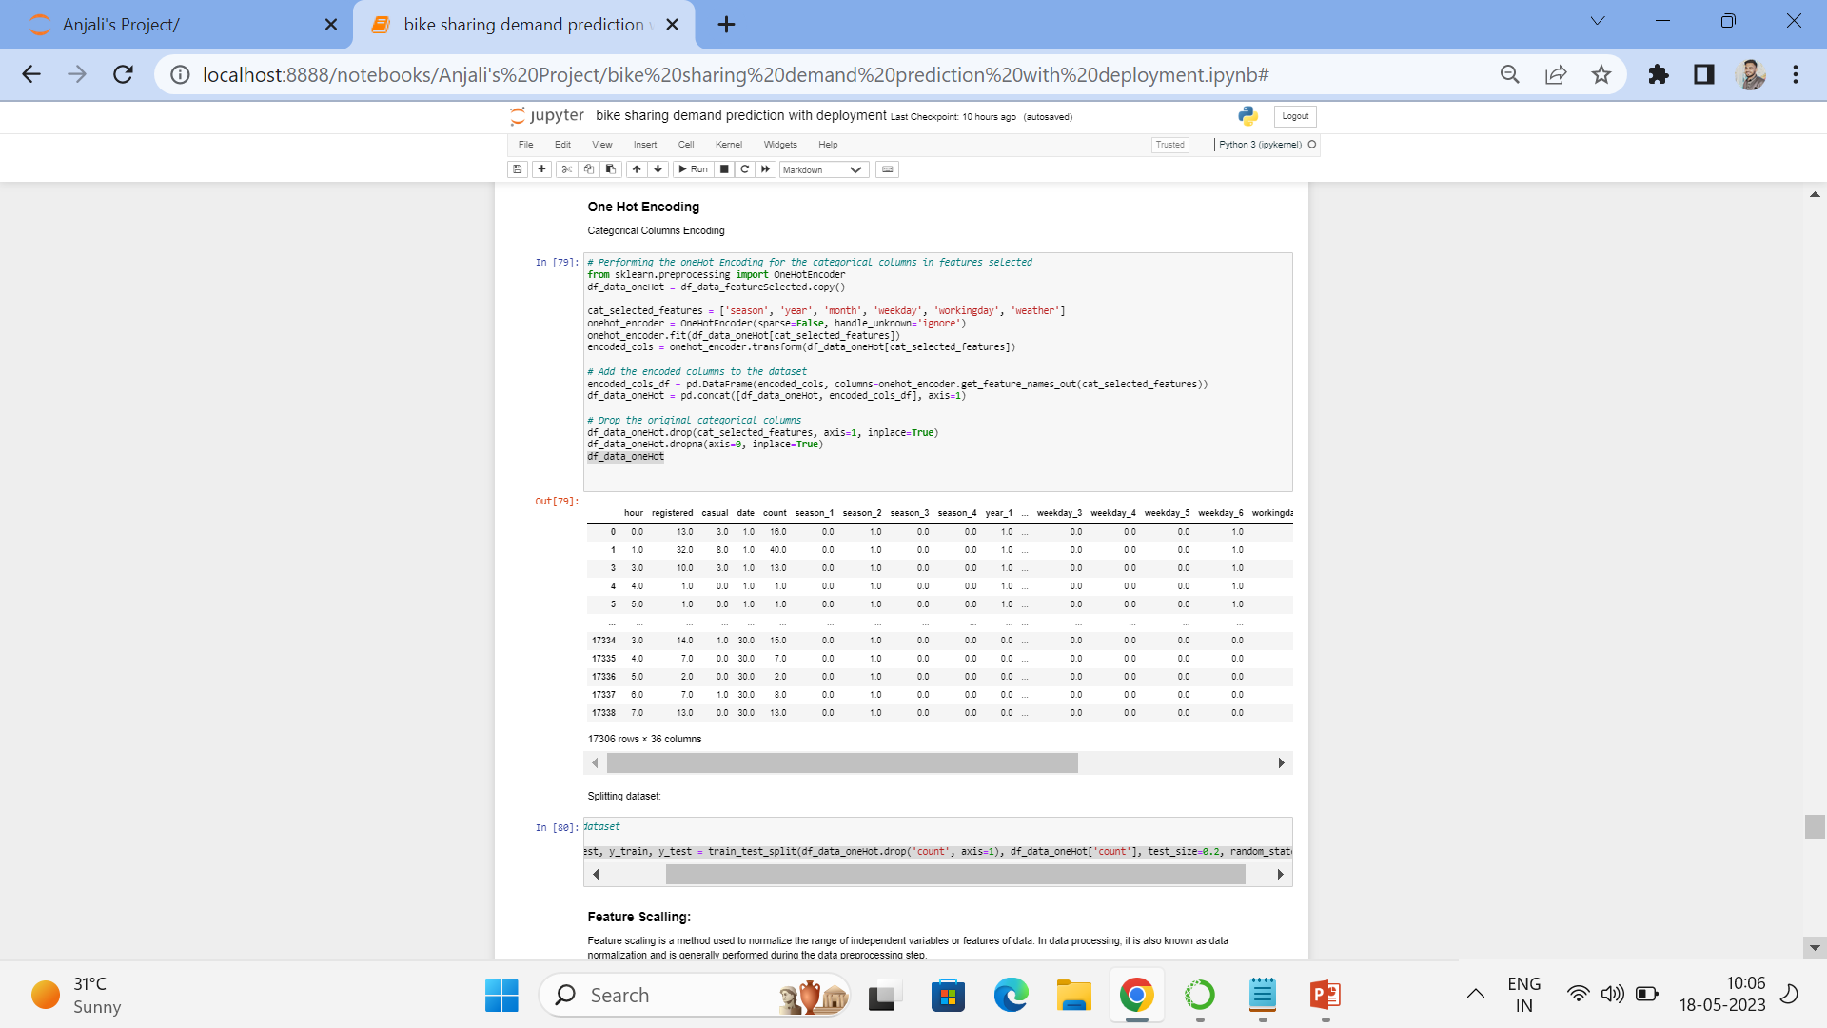
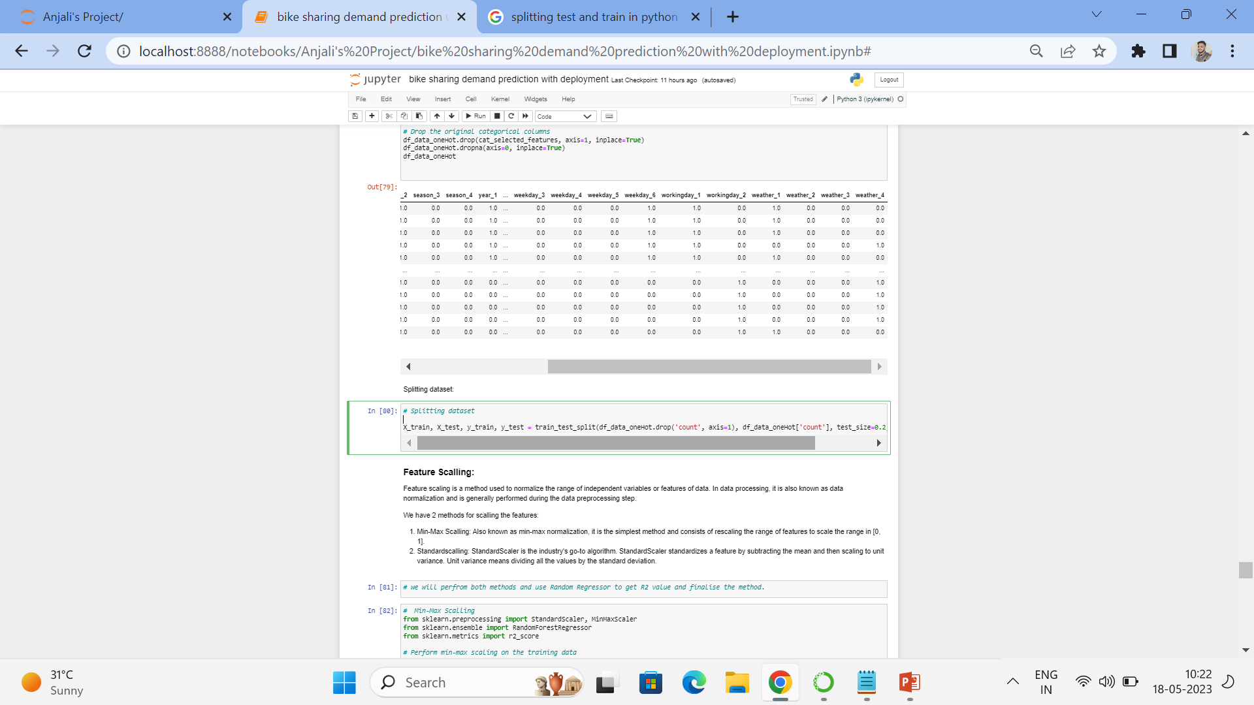
After feature selection we started with One Hot Encoding
as we know is a technique that we use to represent categorical variables as numerical values in a machine learning model
In our dataset we used this for columns 'season', 'year', 'month', 'weekday', 'working day', 'weather‘
After one hot encoding we have done Splitting dataset which the train and test split

Slide 15
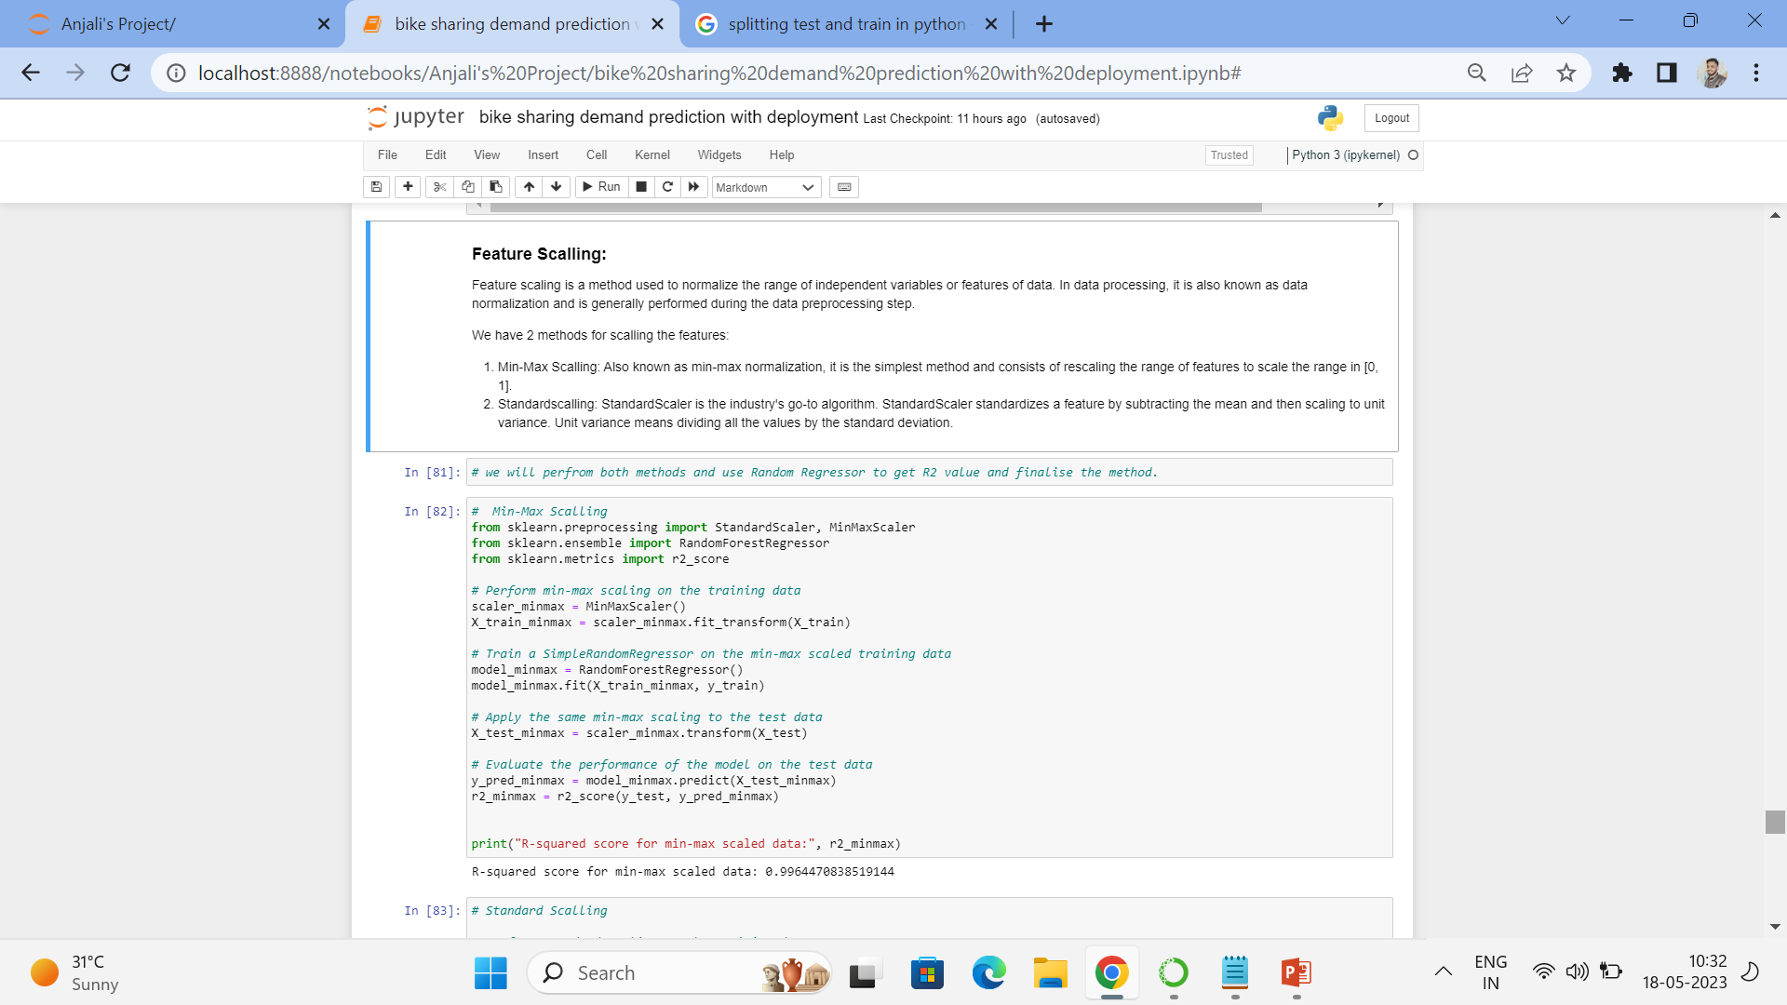
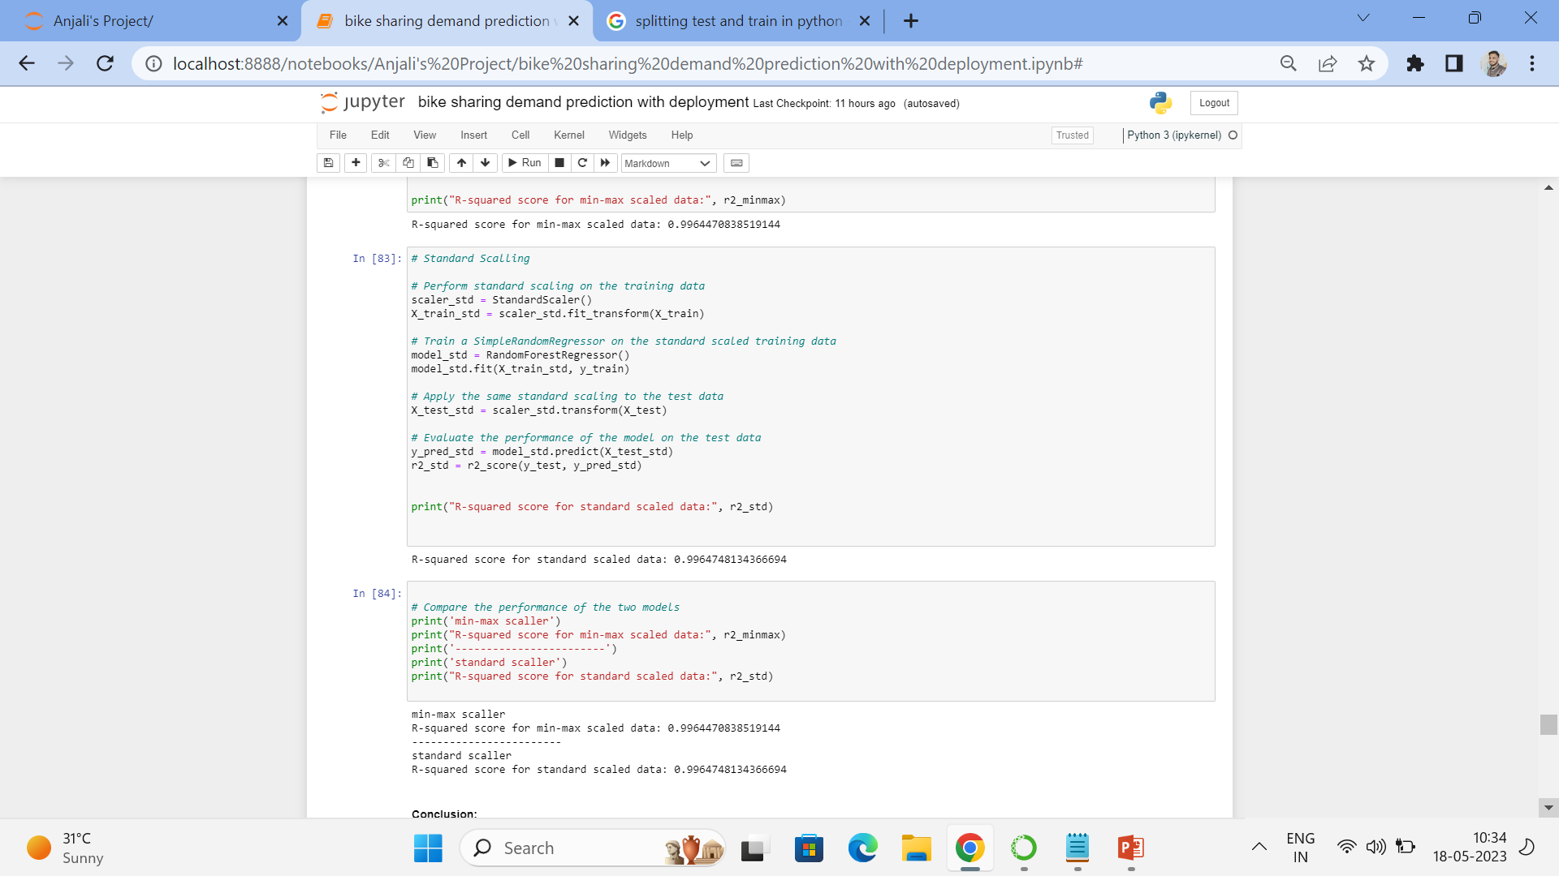
-
After Splitting we started Feature Scaling Feature scaling is a method used to normalize the range of independent variables or features of data . We 2 methods for scaling the features:
Min-Max Scaling: Also known as min-max normalization, it is the simplest method and consists of rescaling the range of features to scale the range in [0, 1].
Standardscaling: StandardScaler is the industry's go-to algorithm. StandardScaler standardizes a feature by subtracting the mean and then scaling to unit variance. Unit variance means dividing all the values by the standard deviation.
squared score for min-max scaled data: 0.9964470838519144 and R-squared score for standard scaled data: 0.9964748134366694 .
from above we concluded that both methods are best for our dataset. we have narrow range of values then we considered using standardScaler.

Slide 16
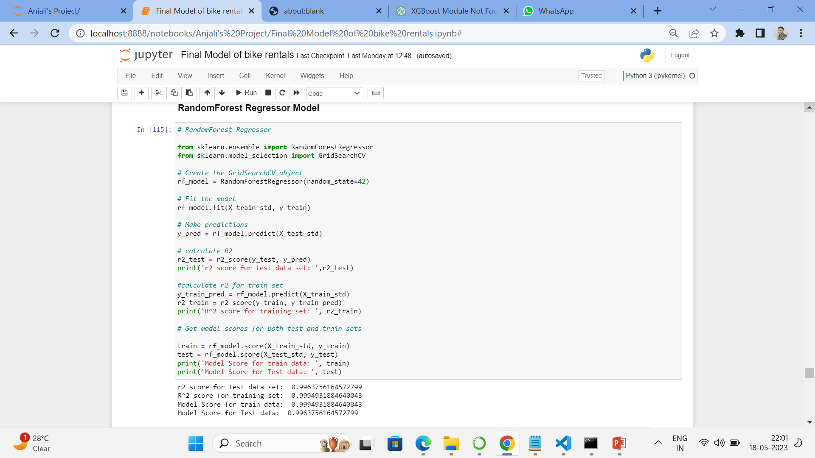
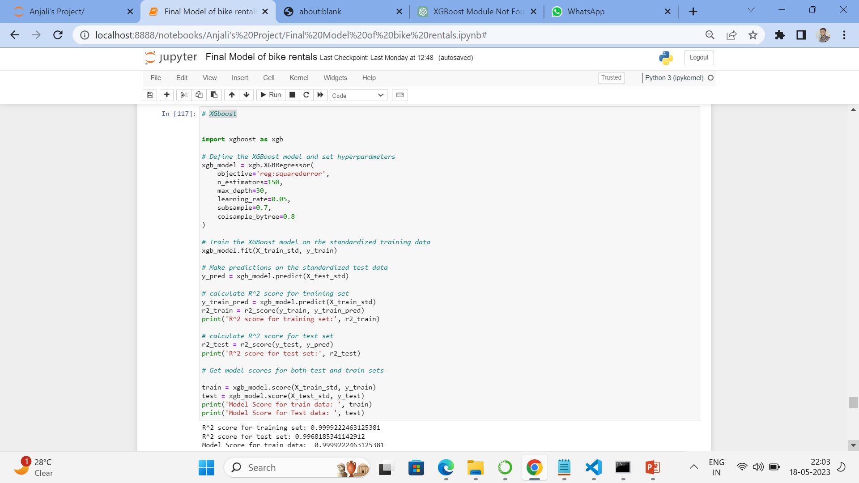
Model Building:
We have build almost 4-5 models on this data set
that followed below:
Decision Tree Regression model
Random forest regression model
XtremeGradient Boosting Regressor Model
KNeighbors Regressor Model(KNN)
SVM Model
This Models will help us understand the exact relationship between different variables and how these variables are used to predict the result.
After Evaluate the performance of the models we got model.score(X_train_std,y_train) and model.score(X_test_std,y_test) above 0.95.
Also From above models we got highest model score on all models

Slide 17
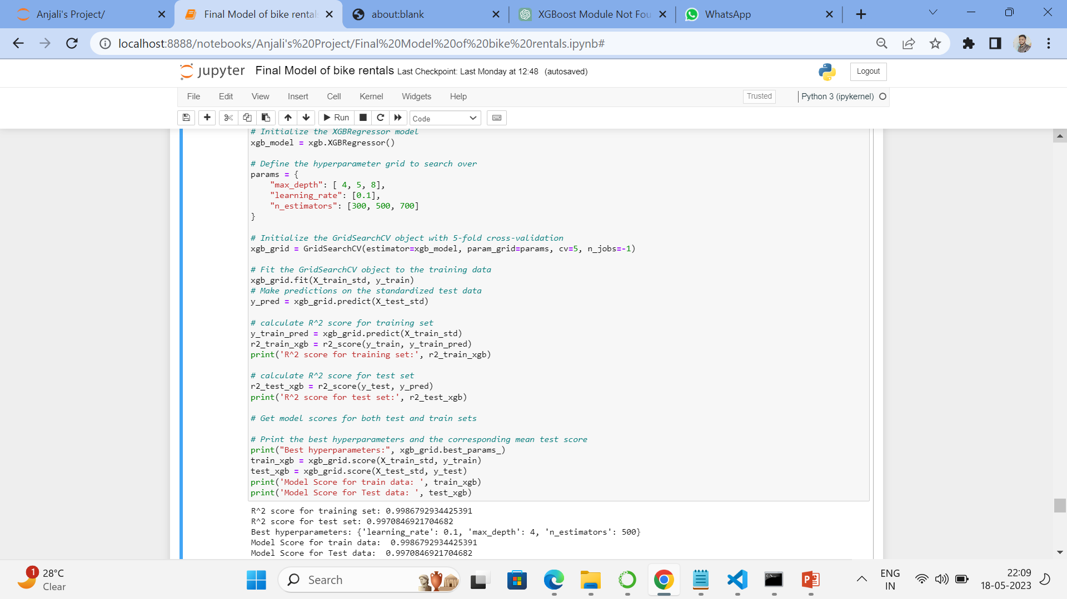
After evaluating performance of model we decided to move forward with xgboost with Model Score for train data: 0.9999222463125381 Model Score for Test data: 0.9968185341142912
Hyperparameter tuning On Xgboost
after selecting this model we wanted have once hyperparameter tuning for getting increased score of the model after doing hyperparameter tuning we got more good score than previous scores. Model Score for train data: 0.9986792934425391 Model Score for Test data: 0.9970846921704682

Slide 18
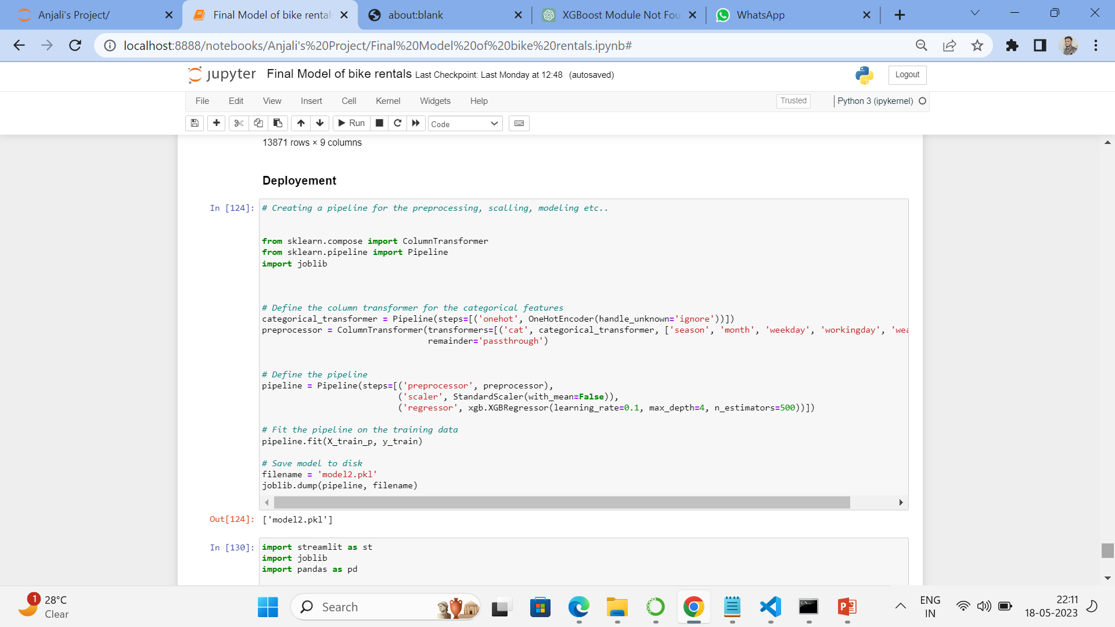
Deployment:
Deployment involves packaging up your web application and putting it in a production environment that can run the app.
When we started with deployment first we have Saved the model using pickle
After saving the model we Load the model from file
Deployement using streamlit
Streamlit is a free and open-source framework to rapidly build and share beautiful machine learning and data science web apps.
After starting streamlit app building we first Set up a new Python file: Create a new Python file (e.g., app.py) where we written our Streamlit app code.
Import Streamlit: Import the Streamlit library into your Python file
We started Writing our app code
Run the app: Saved the Python file and run it using command in our terminal or command prompt
View app: After running the app command, Streamlit will started a local web server and provided a URL. We can Open that URL in our web browser to see our Streamlit app.

Slide 19
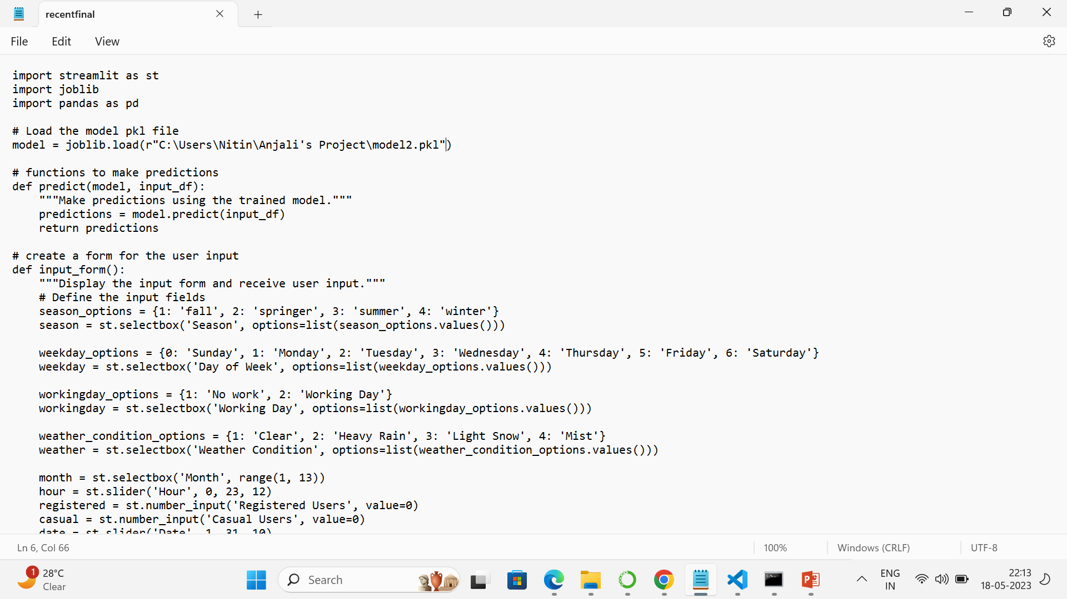
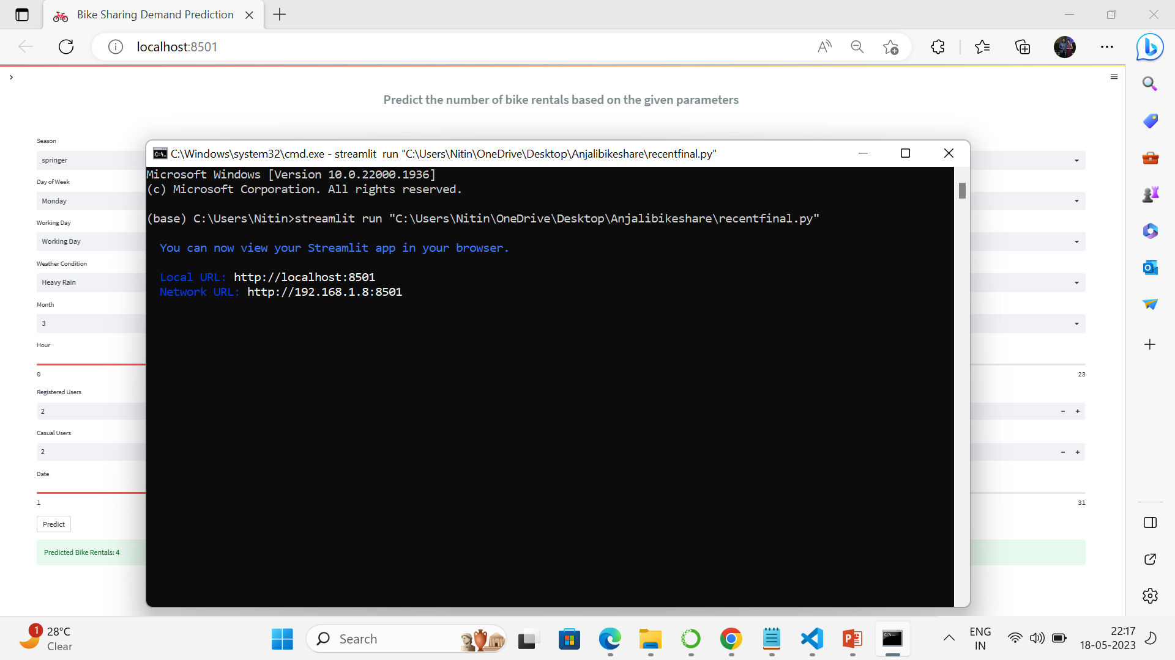
app code
Run the app: Saved the Python file and run it using command in our terminal or command prompt

Slide 20
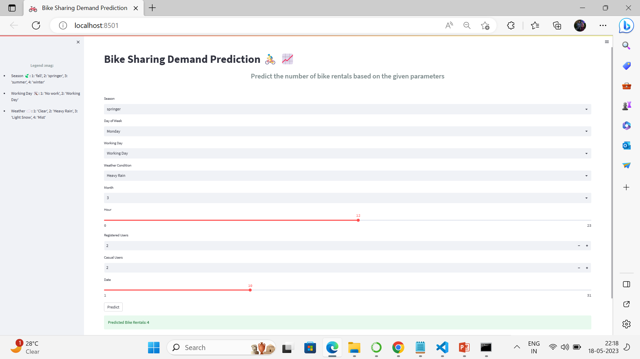
View app: After running the app command, Streamlit will started a local web server and provided a URL and by using this app we can make prediction about the count bike shared

Slide 21


